Slide 1
The great energy challenge: how to avoid the
‘perfect storm’
Maurizio Fermeglia
Università di Trieste
Maurizio.Fermeglia@units.it
www.mose.units.it
Notes:
Tarare su 15 minuti massimo

Slide 2
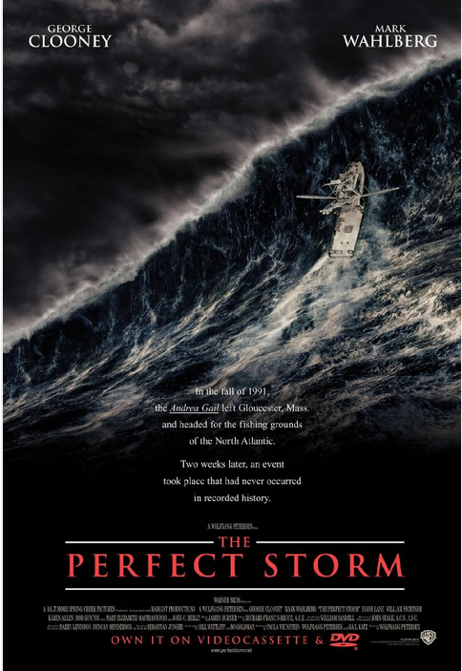
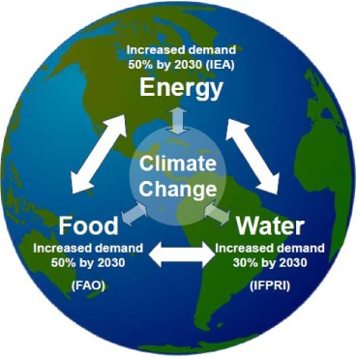
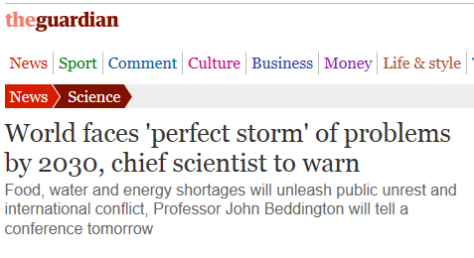
The ‘perfect storm’ of John Beddington
Global population increase (from 6.8 to 8.3 billion)
Reduction of green house gases less than expectations – climate changes ever more evident
Food, energy and water shortage lead to international tension and migrations.

Slide 3
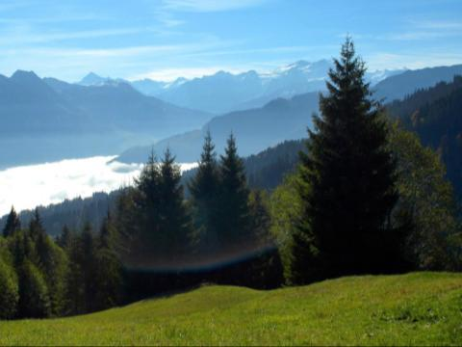
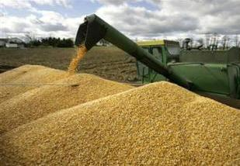

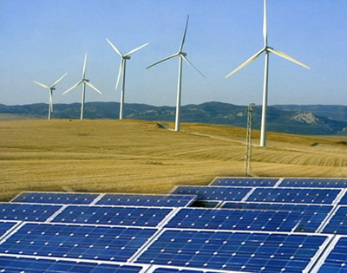
FOOD
ENVIRONMENT
4 World Wide Emergencies
ENERGY
WATER
Richard E. Smalley, Nobel Laureate, Chemistry, 1996, MRS Bulletin, June 2005

Slide 4
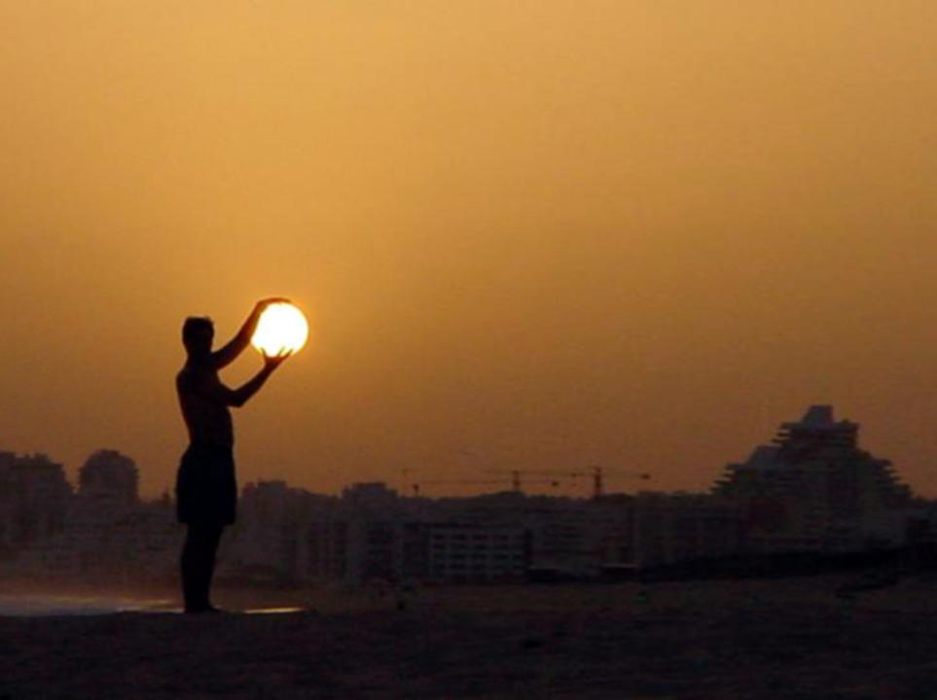
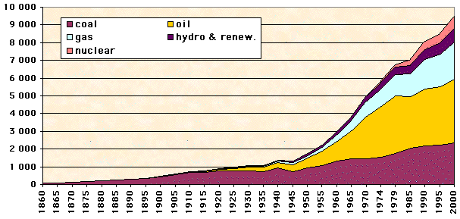
In 2000 about 12 TW
Energy consumed
Mtoe
12.3 TW
WWII
1 Mtoe/anno ~ 1.3GW

Slide 5
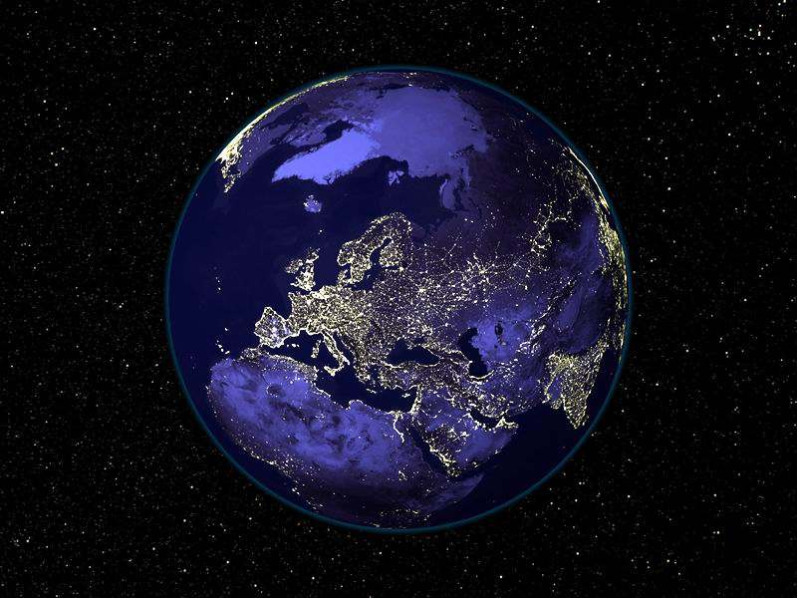
2010 474 exaJ = 15,000,000,000,000 Wh => 17 TW
2030 → 23 TW ; 2058 → 32 TW
Notes:
nel 2010 il consumo di energia primaria e' stato pari a circa 13.000MTOE che corrispondono a circa 150.000TWh che corrispondono a una potenza media annua di circa 17TW

Slide 6
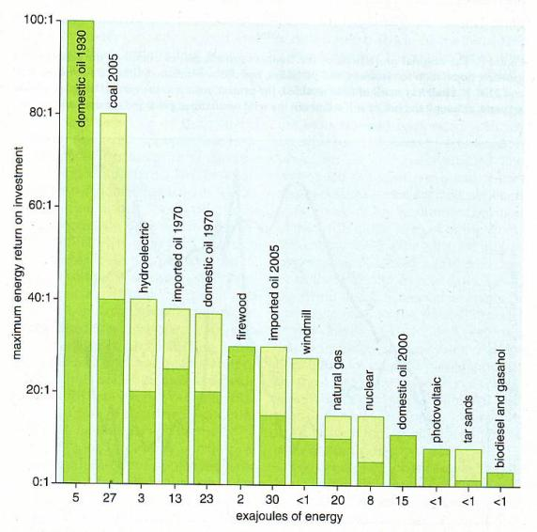
Energy return on energy invested (EROEI)
Energy
Production Process
Raw Materials
Waste
Energy
C.A.S.Hall, J.W.Day Jr.,
“Revisiting the Limits to
Growth After Peak Oil”,
Am. Sci. 97 (2009) 230

Slide 7
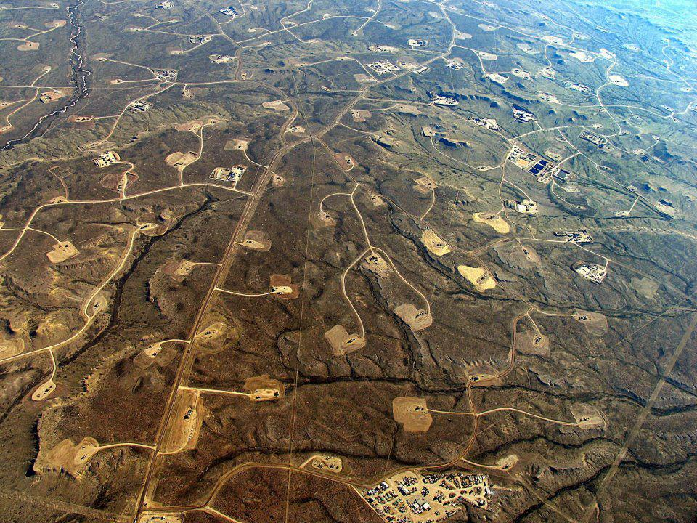
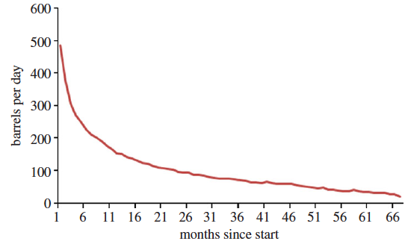
Unconventional fossil fuel: Shale oil & Gas
Average production trend per x well ,
Bakken formation
Montana, USA

Slide 8
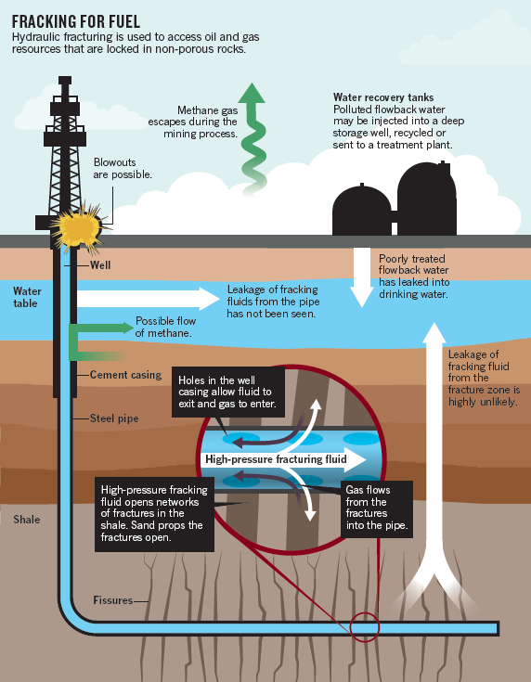
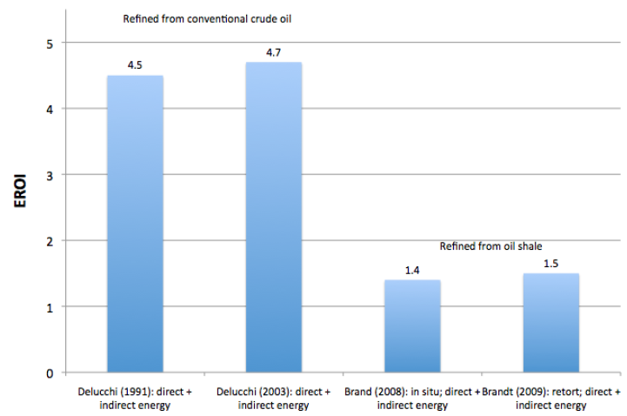
“Fracking”: problems and risks
Ground water contamination
Science 2013, 340, 826
PNAS 2013, 110, 11250
Nature 2013, 498, 415
Increased risk of earthquakes
Science 2013, 341, 142
U.S. NAS Report 2012, ISBN 978-0-309-25367-3
Release of methane in atmosphere
Nature 2012, 482, 139
Fast production decline
Nature 2012, 494, 307
Low EROEI
Environ. Sci. Tech. 2013, 47, 5459
Nature 2011, 477, 271
Notes:
Histogramma si puo’ togliere?

Slide 9
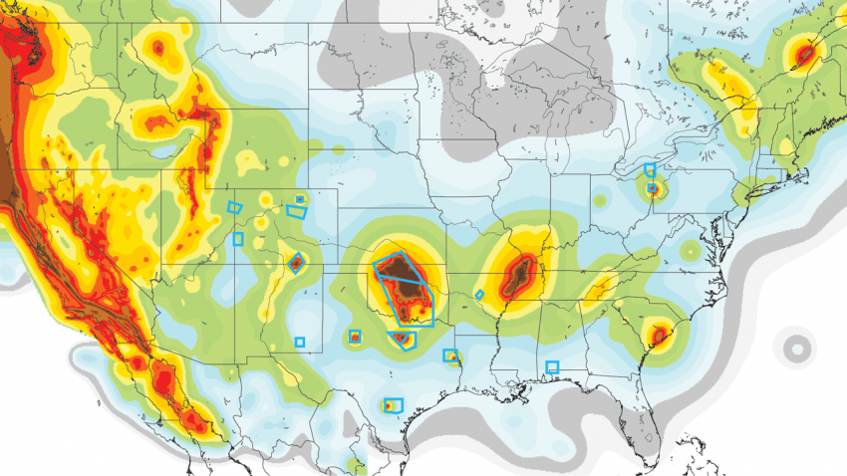
Increase of seismic hazard: the new map shows new seismic areas.
Earthquakes magnitude larger than 3 (Mercalli)
  Between 1973 and 2008 an average of 24/year
  From 2009 to 2015 an average of 318/ year
  Only in 2015 more than 1000
Blue boxes indicate areas with anthropogenic induced seismicity..

Slide 10

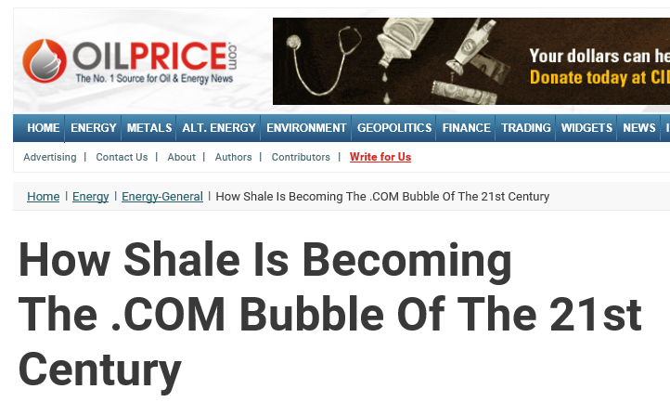
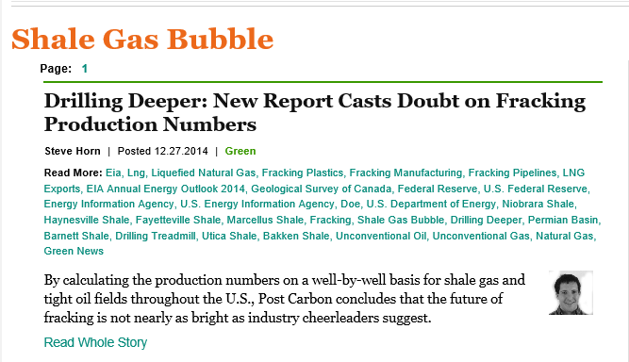

The new USA bubble of shale gas

Slide 11
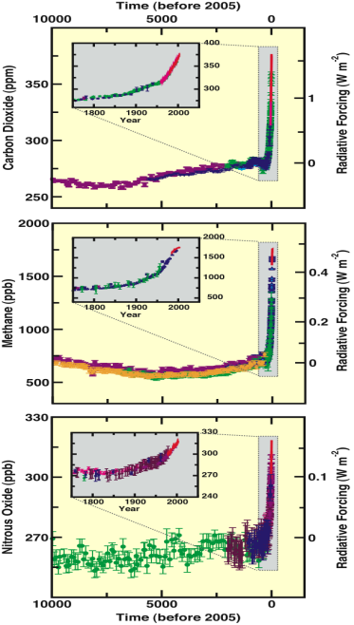
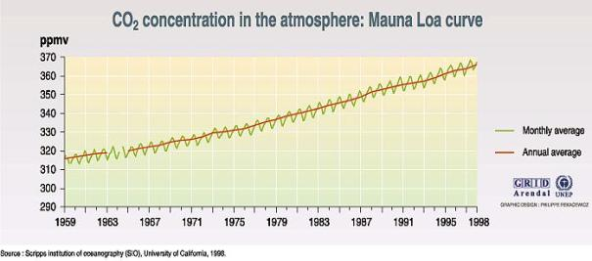
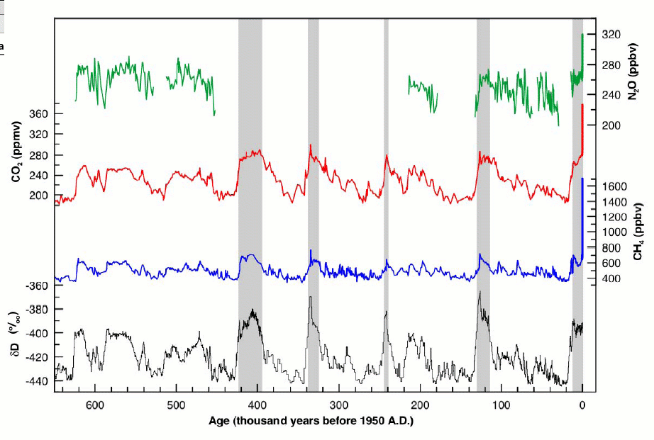
Concentration of greenhouse gases in the athmosphere
2010: 380ppm 1900: 280ppm
CO2
CH4
N2O
CO2
N2O
CH4

Slide 12
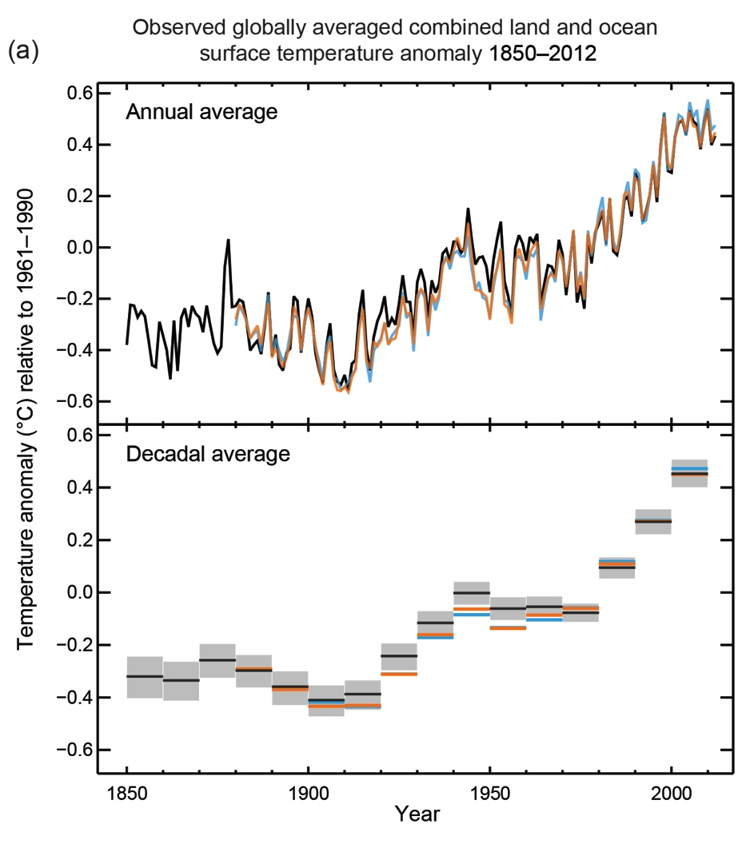
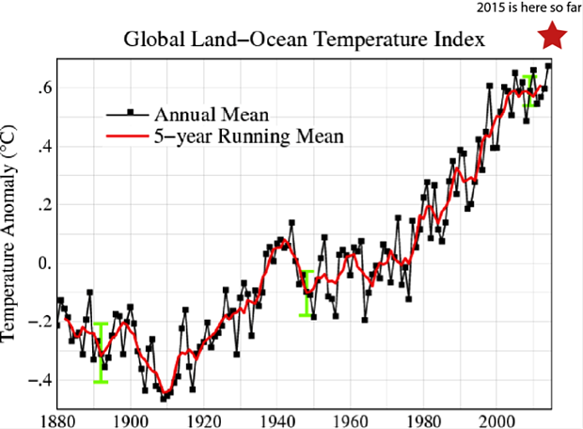
Earth surface temperature has increased by about 0.85 degrees in recent 100 years
The decade 2000-2010 has been the warmest and 2015 the warmest year since instrumental global records.
IPCC 2013

Slide 13
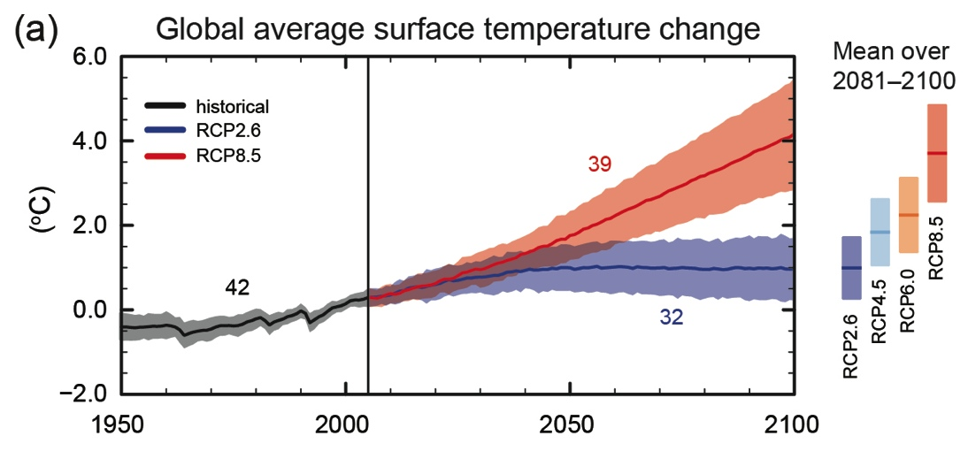
Effect: temperature increase

Slide 14
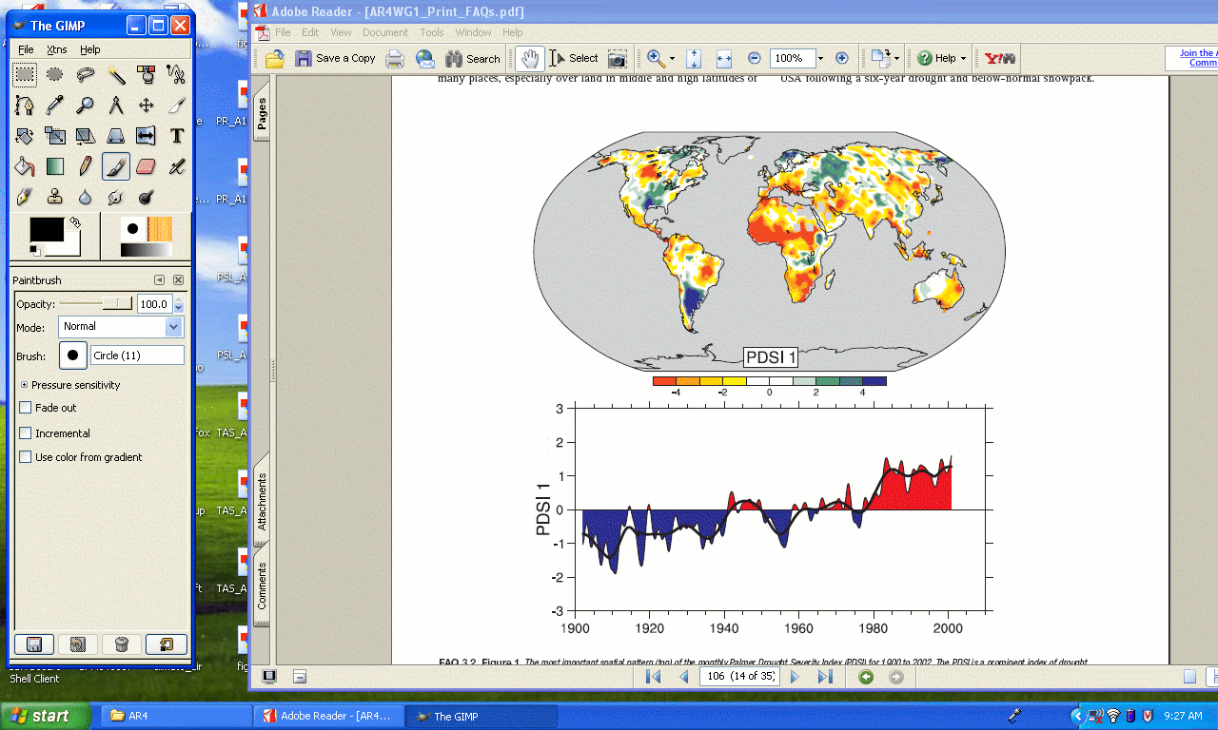
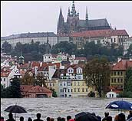
Intensification of hydrologic cycle
More intensive precipitation
“It rains less but more intense”
Increase of draughts
and heat waves

Slide 15
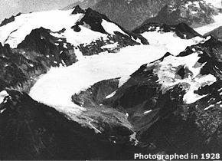
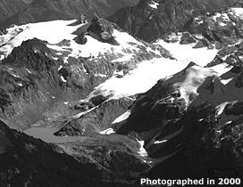
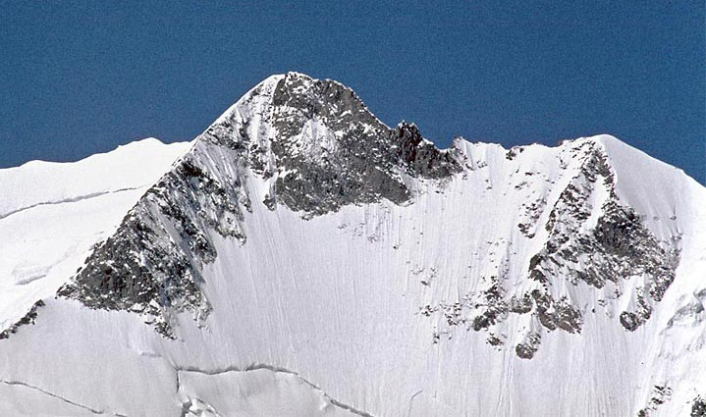
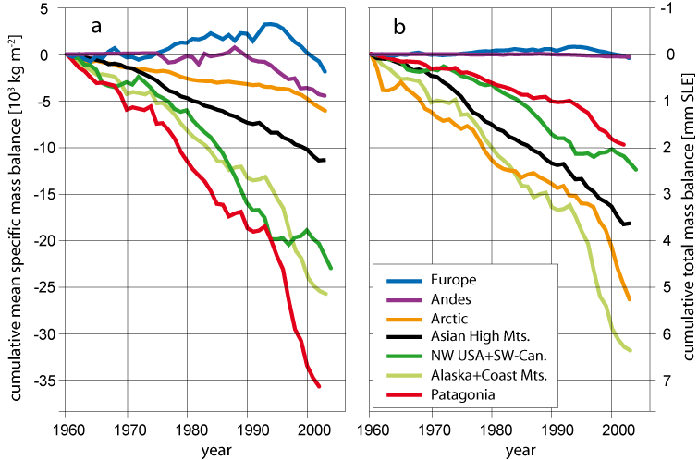
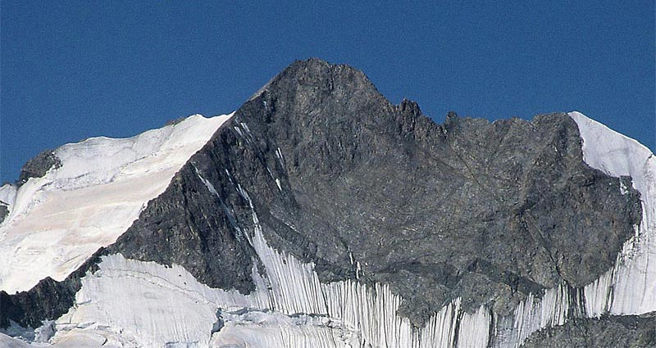
Glaciers melting
Pizzo Bernina, 1978
Pizzo Bernina, 2003
Alps

Slide 16
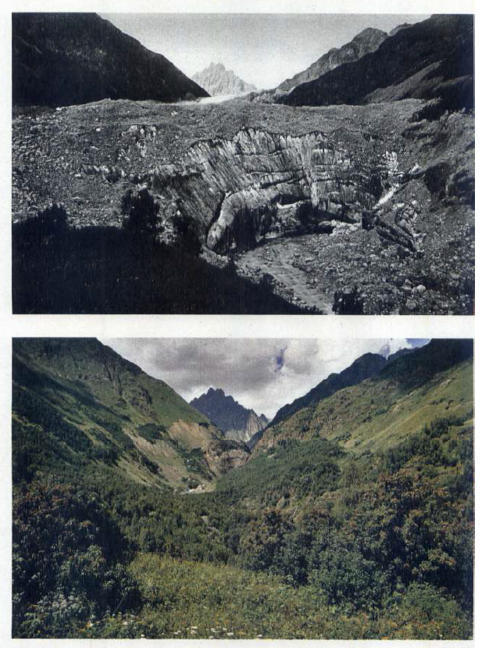
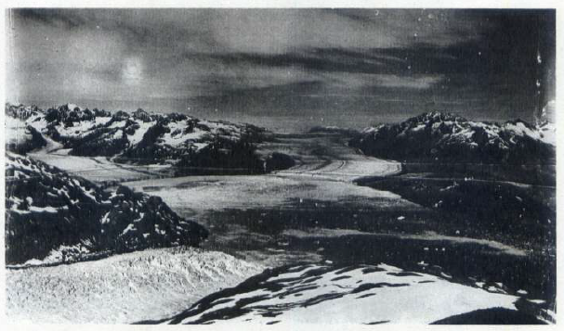
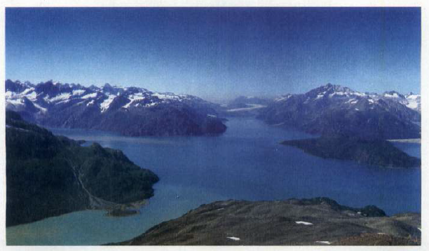
Glacier Tvuiberi, Caucasus – Glacier Reid, Alaska

Slide 17
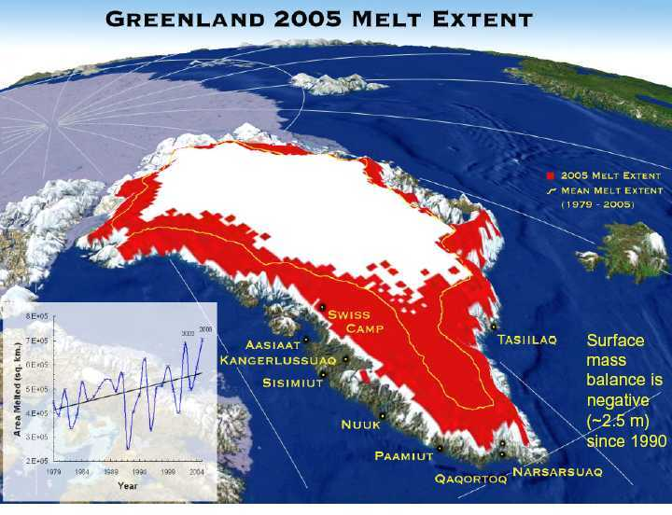
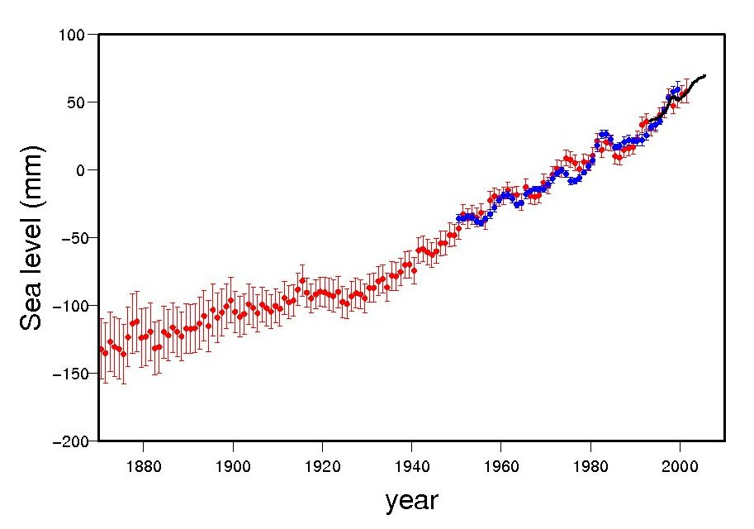
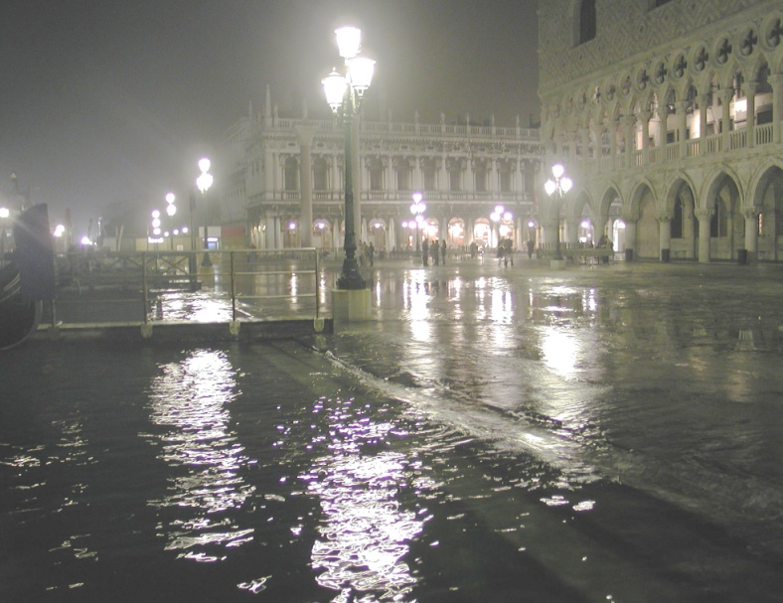
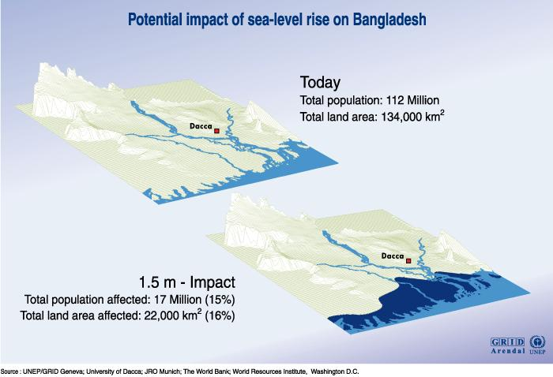
Sea level increase
Global sea level increase about 20 cm since 1880

Slide 18
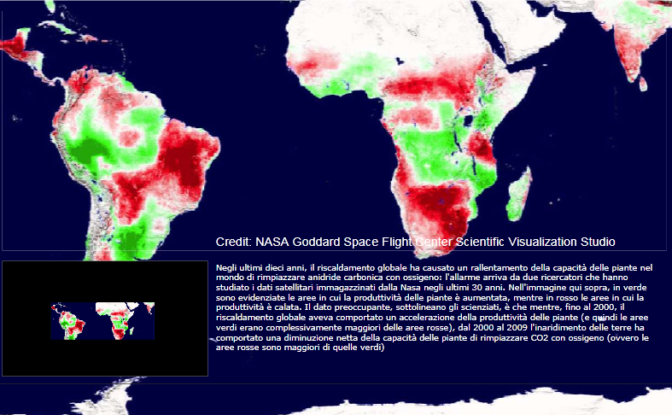
Plant productivity
  In green increase - In red decrease

Slide 19
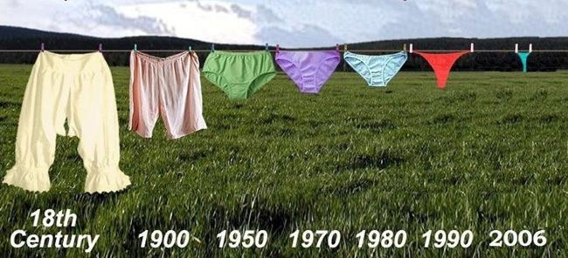
A proof of global change ???

Slide 20
Water means food
Vegetable Product | Water (liters per KG) | Animal products | Water (liters per KG)
Oil | 5000 | Beef | 13,000
Rice | 1500-2000 | Chicken | 4,000
Wheat | 1000 | Eggs | 2,700
Corn | 700 | Milk | 800
Citrus fruits | 400
Vegetables | 200-400
Potatoes | 100

Slide 21
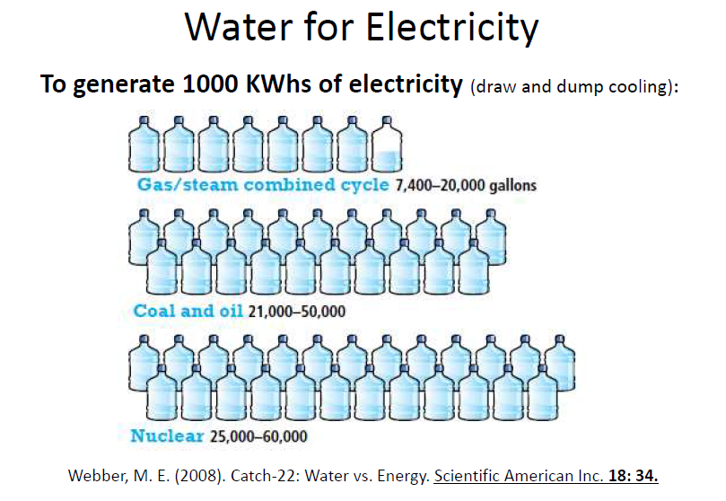
Water means energy

Slide 22
Earth is an isolated system….
… except for solar radiation

Slide 23
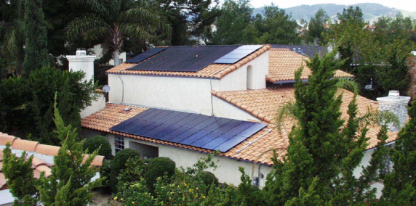
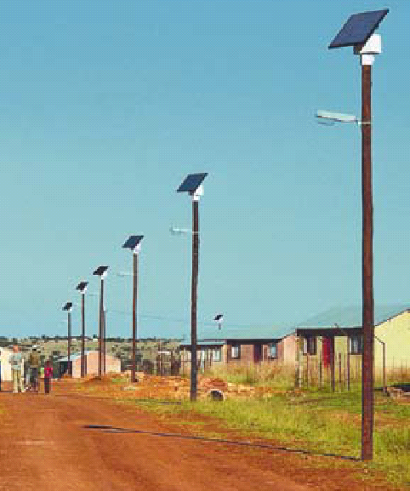
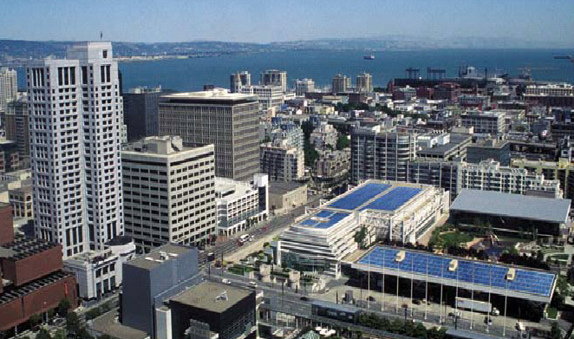
Conversion of solar energy to electric energy: photovoltaic effect

Slide 24


Adair Turner - Financial Services Authority (FSA)
Cause of economic collapse = cause of environmental collapse
Neoliberalism has produced incalculable damages on the financial market.
  Investments from commerce reduced due to loan crisis
Deregulation has caused the same harm to the natural environment
  Low attention to EROEI
  Illusion of shale oil and shale gas
  Little attention to greenhouse effect

Slide 25
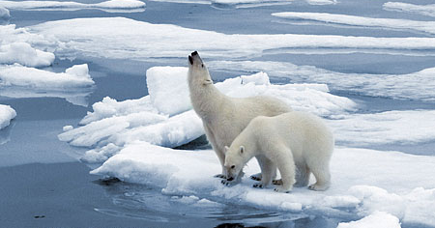

“Stone age did not terminate because stones were used up; …
… the oil era will not end with the exhaust of oil resources”
Don Huberts
Notes:
25

